Slide 1



Dev’s Code
Home
About
Services
Portfolio
Contact
ANOMALY DETECTION
ZERO SHOT IMAGE CLASSIFICATION

Slide 2
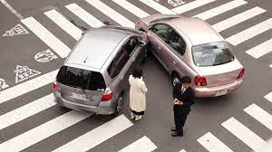

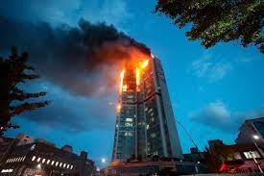
Dev’s Code
Home
About
Services
Portfolio
Contact
AIM
Social Impact
Objective
Application
Enhanced Security and
Safety
Reduced Human Workload
Privacy Friendly anomaly detection
The primary objective of our project is to develop an efficient and accurate anomaly detection system using the CHiLS model
The CHiLS (CLIP-based Hybrid Learning for Anomaly Detection) model can be effectively employed for detecting various anomalies in videos, including car accidents, fires, and robberies.

Slide 3

Zero-shot classification is a groundbreaking task in the field of natural language processing. It involves training a model on a set of labeled examples and then enabling it to classify new examples from previously unseen classes. This innovative approach transcends traditional limitations, allowing the model to predict classes that it was not specifically trained on.
Primarily, zero-shot classification involves providing the model with a prompt and a sequence of text that describes the desired classification in natural language. This method of classification is an emergent feature of large language models, typically becoming prominent around model sizes of 100M+ parameters.
What is ZEROSHOT
IMAGE CLASSIFICATION?

Slide 4
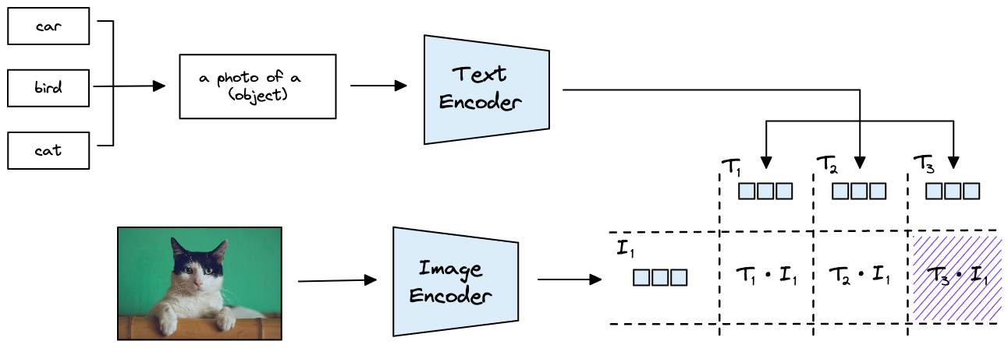
PROJECT OVERVIEW

Slide 5
Dev’s Code
Home
About
Services
Portfolio
Contact
Technology Stack
01.
02.
03.
FRONT END
BACK END
Model
REACT J S
.
FAST API
CHiLS

Slide 6
OUR MODEL :
CHiLS
CHilLS stands for Classification with Hierarchical Label Set.
It adapts the pre-trained vision-language model CLIP for accurate zero-shot anomaly detection across different domains.
CLIP (Contrastive Language-Image Pre-training) has demonstrated strong zero-shot recognition ability in various vision tasks.
WHAT WE ARE DOING?
01.
02.
03.
Model Training
Real Time Inference
Alert Generation
We fine-tune CHiLS on a diverse dataset of CCTV frames, annotated with anomaly labels.
The model learns to associate visual features with textual descriptions, enabling zero-shot classification
.
Given a new CCTV frame, CHiLS predicts probabilities for predefined text queries (e.g., “suspicious activity,” “violent behavior”).
If the highest probability exceeds a confidence threshold, we flag the frame as an anomaly
Anomalies trigger real-time alerts to security personnel or automated systems.
Immediate action can be taken to prevent incidents or respond promptly.

